Slide 1
Ch 4 – Threading
NEU 2017

Slide 2
Updates
Compiling the Kernel
IF your configuration file doesn’t compile…
make defconfig
http://www.linux.org/threads/the-linux-kernel-configuring-the-kernel-part-1.4274/

Slide 3
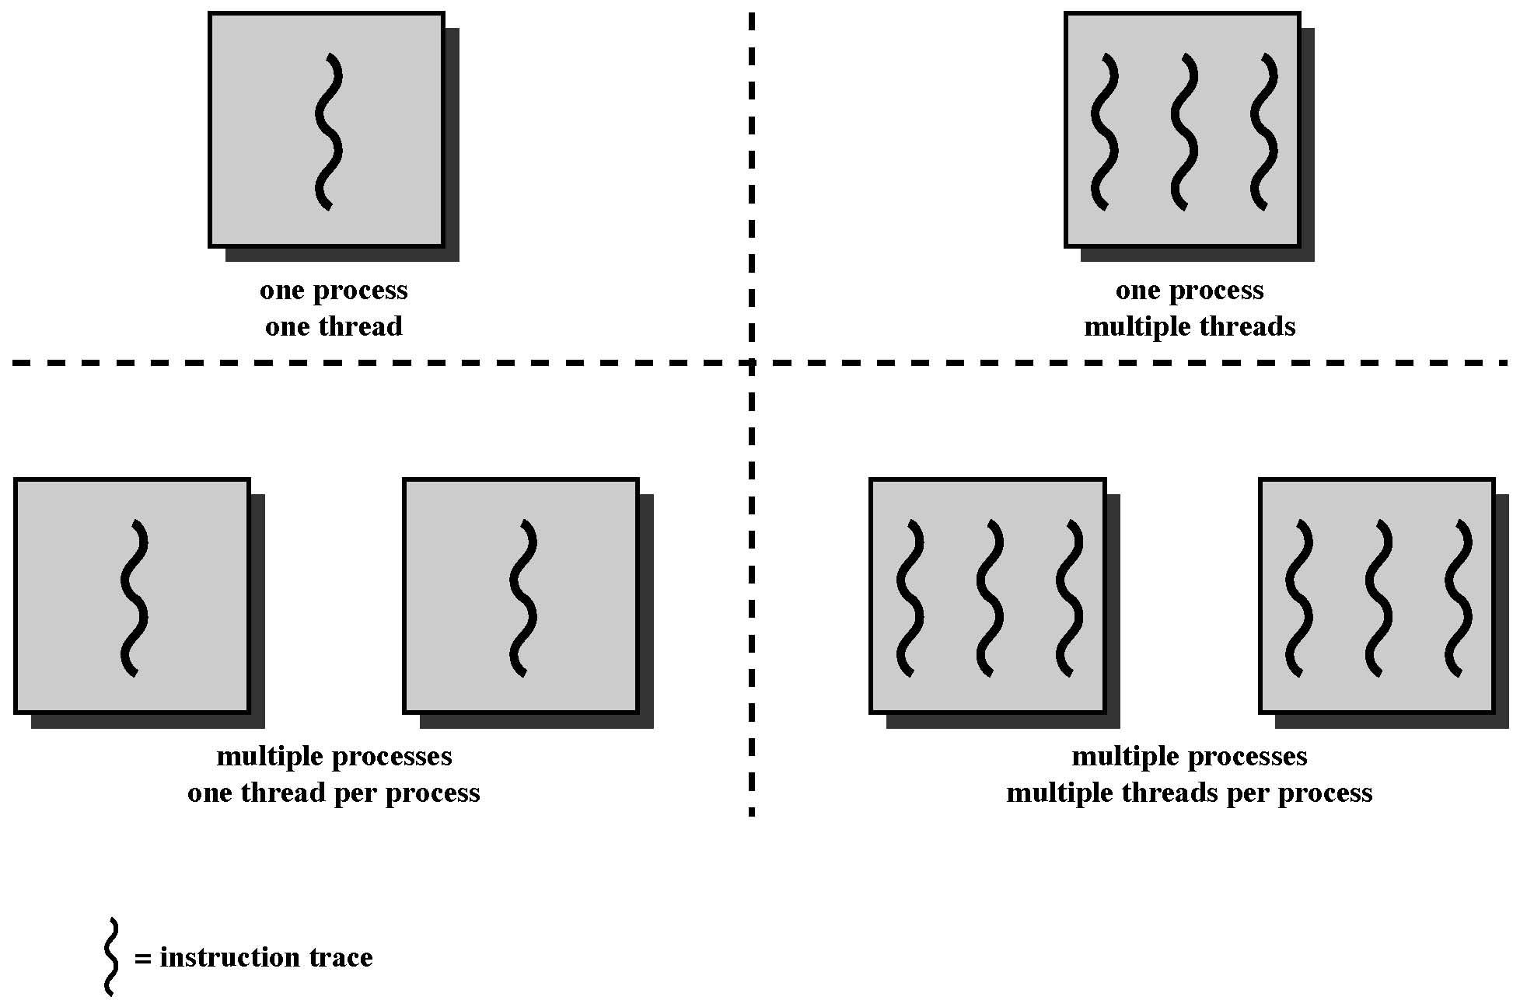
Single-threaded approaches
Multithreaded Approaches
JAVA
run-time environment
MS-DOS
Some variants of UNIX
Windows, Solaris, modern versions of UNIX
Notes:
The traditional approach of a single thread of execution per process, in which the concept of a thread is not recognized, is referred to as a single-threaded approach. The two arrangements shown in the left half of Figure 4.1 are single-threaded approaches. MS-DOS is an example of an OS that supports a single user process and a single thread.
The right half of Figure 4.1 depicts multithreaded approaches. A Java run-time environment is an example of a system of one process with multiple threads. Of interest in this section is the use of multiple processes, each of which supports multiple threads. This approach is taken in Windows, Solaris, and many modern versions of UNIX, among others. In this section we give a general description of multithreading; the details of the Windows, Solaris, and Linux approaches are discussed later in this chapter.

Slide 4
Modern Processes & Threads
Process is an infrastructure in which execution takes place → (address space + resources)
Thread is a program component executing within a process context – each thread has its own execution stack
Stack
Data
Thread
Thread
Stack
Process
…
Program
Stack
Thread
Operating System
Notes:
The discussion so far has presented the concept of a process as embodying two
characteristics:
• Resource ownership: A process includes a virtual address space to hold the
process image; recall from Chapter 3 that the process image is the collection of
program, data, stack, and attributes defined in the process control block. From
time to time, a process may be allocated control or ownership of resources,
such as main memory, I/O channels, I/O devices, and files. The OS performs a
protection function to prevent unwanted interference between processes with
respect to resources.
• Scheduling/execution: The execution of a process follows an execution path
(trace) through one or more programs (e.g., Figure 1.5). This execution may
be interleaved with that of other processes. Thus, a process has an execution
state (Running, Ready, etc.) and a dispatching priority and is the entity that is
scheduled and dispatched by the OS.

Slide 5
One or More Threads in a Process
Each thread has:
an execution state (Running, Ready, etc.)
an execution stack
some static storage for local variables
access to the memory and resources of its process
saved thread context (when not running)
Notes:
Within a process, there may be one or more threads, each with the following:
• A thread execution state (Running, Ready, etc.)
• A saved thread context when not running; one way to view a thread is as an independent program counter operating within a process
• An execution stack
• Some per-thread static storage for local variables
• Access to the memory and resources of its process, shared with all other threads in that process

Slide 6
Notes:
Figure 4.2 illustrates the distinction between threads and processes from the point of view of process management. In a single-threaded process model (i.e., there is no distinct concept of thread), the representation of a process includes its process control block and user address space, as well as user and kernel stacks to manage the call/return behavior of the execution of the process. While the process is running, it controls the processor registers. The contents of these registers are saved when the process is not running. In a multithreaded environment, there is still a single process control block and user address space associated with the process, but now there are separate stacks for each thread, as well as a separate control block for each thread containing register values, priority, and other thread-related state information.

Slide 7
Benefits of Threads
Takes less time to create a new thread than a process
Less time to terminate a thread than a process
Switching between two threads takes less time than switching between processes
Threads enhance efficiency in communication
Notes:
Thus, all of the threads of a process share the state and resources of that process. They reside in the same address space and have access to the same data. When one thread alters an item of data in memory, other threads see the results if and when they access that item. If one thread opens a file with read privileges, other threads in the same process can also read from that file.
The key benefits of threads derive from the performance implications:
1. It takes far less time to create a new thread in an existing process than to
create a brand-new process. Studies done by the Mach developers show that
thread creation is ten times faster than process creation in UNIX [TEVA87].
2. It takes less time to terminate a thread than a process.
3. It takes less time to switch between two threads within the same process than to switch between processes.
4. Threads enhance efficiency in communication between different executing programs. In most operating systems, communication between independent processes requires the intervention of the kernel to provide protection and the mechanisms needed for communication. However, because threads within the same process share memory and files, they can communicate with each other without invoking the kernel.
Thus, if there is an application or function that should be implemented as a set of related units of execution, it is far more efficient to do so as a collection of threads rather than a collection of separate processes.

Slide 8
Thread Examples
Foreground and background work
one thread reading user input, another executing the commands and updating the spreadsheet; yet another making periodic backups
Asynchronous processing
a thread performing periodic backups against power failures in a word-processor
Speed of execution
independent threads can execute in parallel
Modular program structure
different tasks/activities in a program may be implemented using different threads
Client/Server Computing
Notes:
[LETW88] gives four examples of the uses of threads in a single-user multiprocessing system:
• Foreground and background work: For example, in a spreadsheet program,
one thread could display menus and read user input, while another thread executes user commands and updates the spreadsheet. This arrangement often increases the perceived speed of the application by allowing the program to prompt for the next command before the previous command is complete.
• Asynchronous processing: Asynchronous elements in the program can be
implemented as threads. For example, as a protection against power failure, one can design a word processor to write its random access memory (RAM) buffer to disk once every minute. A thread can be created whose sole job is periodic backup and that schedules itself directly with the OS; there is no need for fancy code in the main program to provide for time checks or to coordinate input and output.
• Speed of execution: A multithreaded process can compute one batch of data
while reading the next batch from a device. On a multiprocessor system, multiple threads from the same process may be able to execute simultaneously. Thus, even though one thread may be blocked for an I/O operation to read in a batch of data, another thread may be executing.
• Modular program structure: Programs that involve a variety of activities or a
variety of sources and destinations of input and output may be easier to design and implement using threads.

Slide 9
Threads
Most of the state information dealing with execution is maintained in thread-level data structures
In an OS that supports threads, scheduling and dispatching is done on a thread basis
suspending a process involves suspending all threads of the process
termination of a process terminates all threads within the process
Notes:
In an OS that supports threads, scheduling and dispatching is done on a thread basis; hence, most of the state information dealing with execution is maintained in thread-level data structures. There are, however, several actions that affect all of the threads in a process and that the OS must manage at the process level. For example, suspension involves swapping the address space of one process out of main memory to make room for the address space of another process. Because all threads in a process share the same address space, all threads are suspended at the same time. Similarly, termination of a process terminates all threads within that process.

Slide 10
Thread Execution States
Thread operations associated with a change in thread state are:
Spawn
Block
Unblock
Finish
The key states for a thread are:
Running
Ready
Blocked
Suspend?
Notes:
As with processes, the key states for a thread are Running, Ready, and Blocked. Generally, it does not make sense to associate suspend states with threads because such states are process-level concepts. In particular, if a process is swapped out, all of its threads are necessarily swapped out because they all share the address space of the process. There are four basic thread operations associated with a change in thread state [ANDE04]:
• Spawn: Typically, when a new process is spawned, a thread for that process is also spawned. Subsequently, a thread within a process may spawn
another thread within the same process, providing an instruction pointer and arguments for the new thread. The new thread is provided with its own register context and stack space and placed on the ready queue.
• Block: When a thread needs to wait for an event, it will block (saving its user registers, program counter, and stack pointers). The processor may now turn to the execution of another ready thread in the same or a different process.
• Unblock: When the event for which a thread is blocked occurs, the thread is moved to the Ready queue.
• Finish: When a thread completes, its register context and stacks are deallocated.

Slide 11
Notes:
A significant issue is whether the blocking of a thread results in the blocking of the entire process. In other words, if one thread in a process is blocked, does this prevent the running of any other thread in the same process even if that other thread is in a ready state? Clearly, some of the flexibility and power of threads is lost if the one blocked thread blocks an entire process.
We return to this issue subsequently in our discussion of user-level versus kernel-level threads, but for now let us consider the performance benefits of threads that do not block an entire process. Figure 4.3 (based on one in [KLEI96]) shows a program that performs two remote procedure calls (RPCs) to two different hosts to obtain a combined result. In a single-threaded program, the results are obtained in sequence, so the program has to wait for a response from each server in turn. Rewriting the program to use a separate thread for each RPC results in a substantial speedup. Note that if this program operates on a uniprocessor, the requests must be generated sequentially and the results processed in sequence; however, the program waits concurrently for the two replies.

Slide 12
Notes:
On a uniprocessor, multiprogramming enables the interleaving of multiple
threads within multiple processes. In the example of Figure 4.4, three threads in
two processes are interleaved on the processor. Execution passes from one thread
to another either when the currently running thread is blocked or when its time slice
is exhausted.

Slide 13
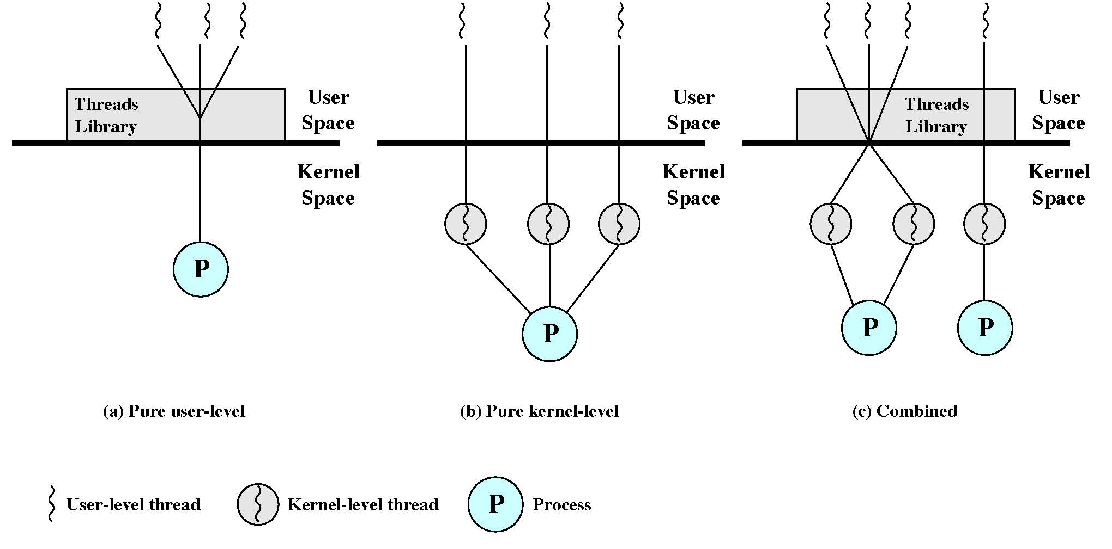
User-Level Threads (ULT)
All thread management is done by the application
The kernel is not aware of the existence of threads and schedules the process as a unit and assigns a single execution state (Ready, Running, Blocked, etc.)
Any application can be programmed to be multithreaded by using a threads library which contains code for creating and destroying threads, for passing messages and data between threads, for scheduling thread execution, and for saving and restoring thread contexts.
Disadvantages:
when a ULT executes a blocking system call, all of the threads within the same process are blocked
can not take advantage of multiprocessing

Slide 14
Kernel-Level Threads (KLT)
Examples include Windows & Linux
All of the work of thread management is done by the kernel. i.e. no thread management code in the program.
Kernel maintains context information for the process as a whole and for individual threads within the process
Scheduling is done by the kernel on a thread basis
Advantages:
Kernel can simultaneously schedule multiple threads from the same process on multiple processors
If one thread in a process is blocked, the kernel can schedule another thread of the same process
Disadvantage: transfer of control from one thread to the next in the same process requires a mode switch to the kernel

Slide 15
Combined Approaches
Example: SUN Solaris
Thread creation, destruction, bulk of scheduling and synchronization are done in the user space.
multiple threads within the same application can run in parallel on multiple processors
if one is blocked, another thread within the same application need not block

Slide 16
Table 4.2
Relationship between Threads and Processes
Notes:
As we have said, the concepts of resource allocation and dispatching unit have traditionally been embodied in the single concept of the process—that is, as a 1 : 1 relationship between threads and processes. Recently, there has been much interest in providing for multiple threads within a single process, which is a many-to-one relationship. However, as Table 4.2 shows, the other two combinations have also been investigated, namely, a many-to-many relationship and a one-to-many relationship.
The idea of having a many-to-many relationship between threads and processes has been explored in the experimental operating system TRIX [PAZZ92, WARD80]. In TRIX, there are the concepts of domain and thread. A domain is a static entity, consisting of an address space and “ports” through which messages may be sent and received. A thread is a single execution path, with an execution stack, processor state, and scheduling information.
As with the multithreading approaches discussed so far, multiple threads may execute in a single domain, providing the efficiency gains discussed earlier. However, it is also possible for a single user activity, or application, to be performed in multiple domains. In this case, a thread exists that can move from one domain to another.

Slide 17
Parallel Execution
Speedup = time to execute on a single processor / time to execute on N parallel processors
Notes:
The potential performance benefits of a multicore organization depend on the ability to effectively exploit the parallel resources available to the application. Let us focus first on a single application running on a multicore system. Amdahl’s law (see Appendix E ) states that:
Speedup = time to execute program on a single processor time to execute program on N parallel processors
= 1 (1 - f ) + f N
The law assumes a program in which a fraction (1 - f) of the execution time involves code that is inherently serial and a fraction f that involves code that is infinitely parallelizable with no scheduling overhead. This law appears to make the prospect of a multicore organization attractive. But as Figure 4.7a shows, even a small amount of serial code has a noticeable impact. If only 10% of the code is inherently serial ( f = 0.9) , running the program on a multicore system with eight processors yields a performance gain of only a factor of 4.7. In addition, software typically incurs overhead as a result of communication and distribution of work to multiple processors and cache coherence overhead. This
results in a curve where performance peaks and then begins to degrade because of the increased burden of the overhead of using multiple processors. Figure 4.7b , from [MCDO07], is a representative example.

Slide 18
Applications That Benefit
Multithreaded native applications
characterized by having a small number of highly threaded processes
Multiprocess applications
characterized by the presence of many single-threaded processes
Java applications
Multiinstance applications
multiple instances of the application in parallel
Notes:
In addition to general-purpose server software, a number of classes of applications benefit directly from the ability to scale throughput with the number of cores. [MCDO06] lists the following examples:
• Multithreaded native applications:
Multithreaded applications are characterized by having a small number of highly threaded processes. Examples of threaded applications include Lotus Domino or Siebel CRM (Customer Relationship Manager).
• Multiprocess applications:
Multiprocess applications are characterized by the presence of many single-threaded processes. Examples of multiprocess applications include the Oracle database, SAP, and PeopleSoft.
• Java applications:
Java applications embrace threading in a fundamental way. Not only does the Java language greatly facilitate multithreaded applications, but the Java Virtual Machine is a multithreaded process that provides scheduling and memory management for Java applications. Java applications that can benefit directly from multicore resources include application servers such
as Sun’s Java Application Server, BEA’s Weblogic, IBM’s Websphere, and the open-source Tomcat application server. All applications that use a Java 2 Platform, Enterprise Edition (J2EE platform) application server can immediately benefit from multicore technology.
Multiinstance applications:
Even if an individual application does not scale to take advantage of a large number of threads, it is still possible to gain from multicore architecture by running multiple instances of the application in parallel. If multiple application instances require some degree of isolation, virtualization technology (for the hardware of the operating system) can be used to provide each of them with its own separate and secure environment.

Slide 19
Hyper-threading?
Hyper-threading (officially called Hyper-Threading Technology or HT Technology, and abbreviated as HTT or HT) is Intel's proprietary simultaneous multithreading (SMT) implementation used to improve parallelization of computations performed on x86 microprocessors. It first appeared in February 2002 on Xeon server processors and in November 2002 on Pentium 4 desktop CPUs.[1] Later, Intel included this technology in Itanium, Atom, and Core 'i' Series CPUs, among others.
Notes:
https://en.wikipedia.org/wiki/Hyper-threading

Slide 20
Are Intel’s HTT processors (e.g., Pentium 4 HT) multicore?
Yes
No

Slide 21
Hyper-threading = logical cores
For each processor core that is physically present, the operating system addresses two virtual or logical cores, and shares the workload between them when possible. The main function of hyper-threading is to increase the number of independent instructions in the pipeline; it takes advantage of superscalar architecture, in which multiple instructions operate on separate data in parallel. With HTT, one physical core appears as two processors to the operating system, which can use each core to schedule two processes at once. In addition, two or more processes can use the same resources: if resources for one process are not available, then another process can continue if its resources are available.

Slide 22
Updates
Learning Linux Basics (The Shell)
Working in the Linux shell
http://linuxcommand.org/lc3_learning_the_shell.php
Installing VirtualBox (Install the version of the OS you currently use)
http://people.westminstercollege.edu/faculty/ggagne/osc/vm/
Open a terminal, navigate to a specific directory, attempt to compile/execute a program

